Slide 1
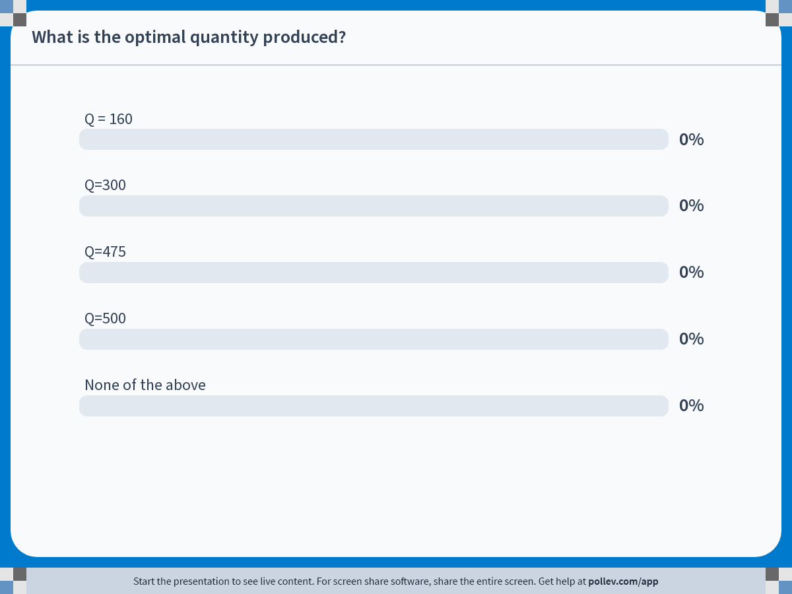
Notes:
Poll Title: Do not modify the notes in this section to avoid tampering with the Poll Everywhere activity. More info at polleverywhere.com/support What is the optimal quantity produced? https://www.polleverywhere.com/multiple_choice_polls/Zwza1GbC7sIapRu20fIpK?state=opened&flow=Default&onscreen=persist

Slide 2
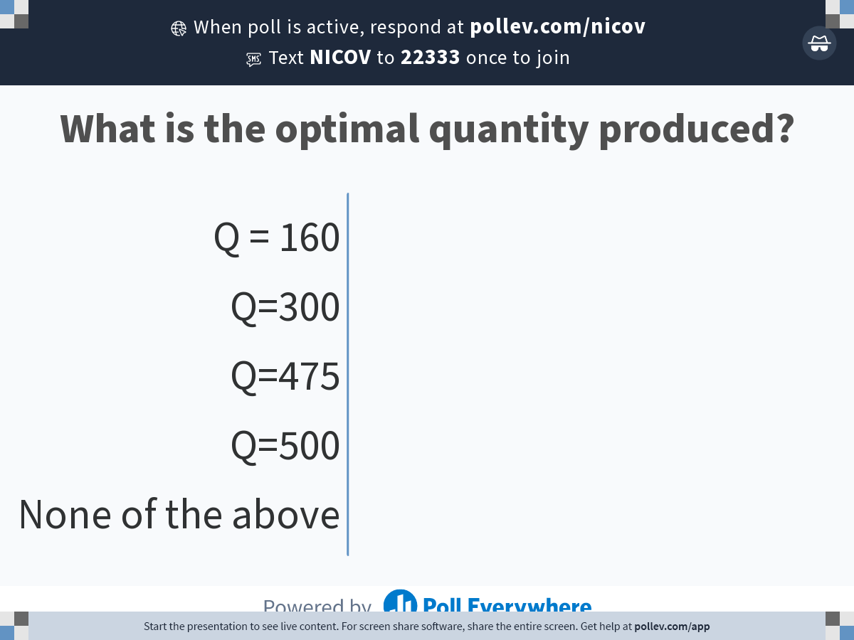
Notes:
Poll Title: Do not modify the notes in this section to avoid tampering with the Poll Everywhere activity. More info at polleverywhere.com/support What is the optimal quantity produced? https://www.polleverywhere.com/multiple_choice_polls/Zwza1GbC7sIapRu20fIpK?display_state=chart&activity_state=opened&state=opened&flow=Default&onscreen=persist

Slide 3
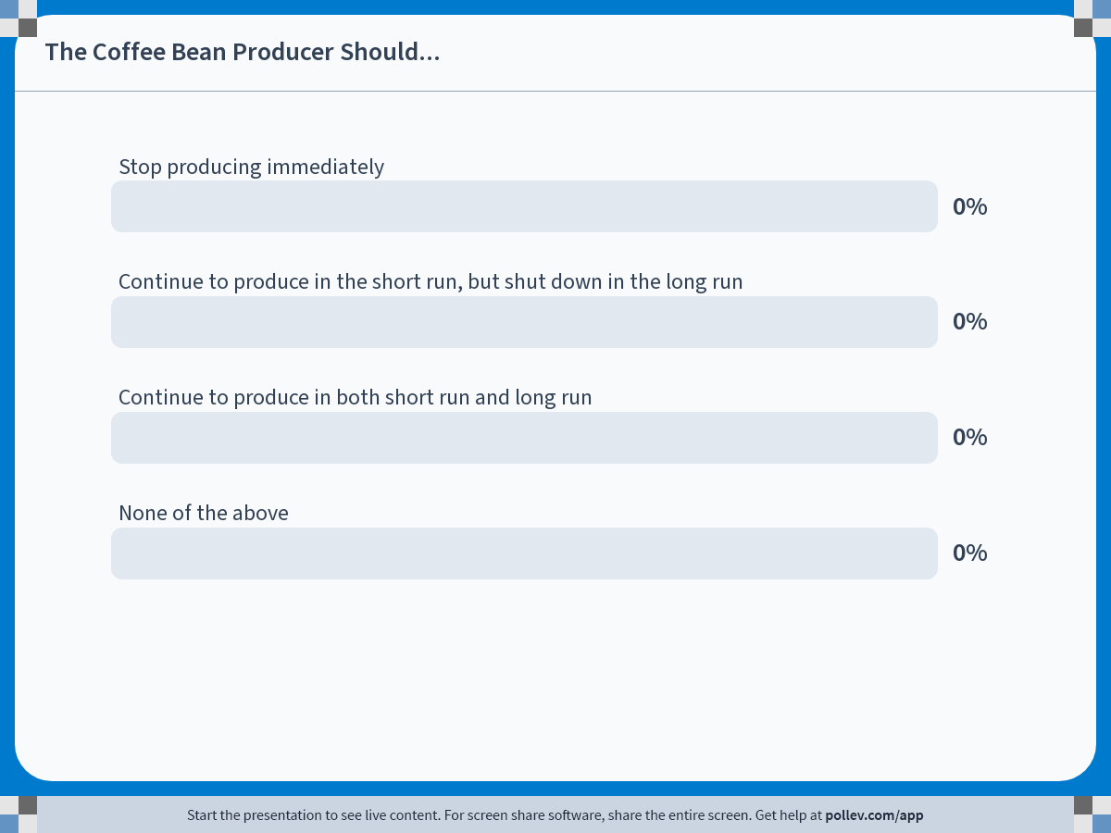
Notes:
Poll Title: Do not modify the notes in this section to avoid tampering with the Poll Everywhere activity. More info at polleverywhere.com/support The Coffee Bean Producer Should... https://www.polleverywhere.com/multiple_choice_polls/sry3DICjteteqyV1Ny4gL?state=opened&flow=Default&onscreen=persist

Slide 4
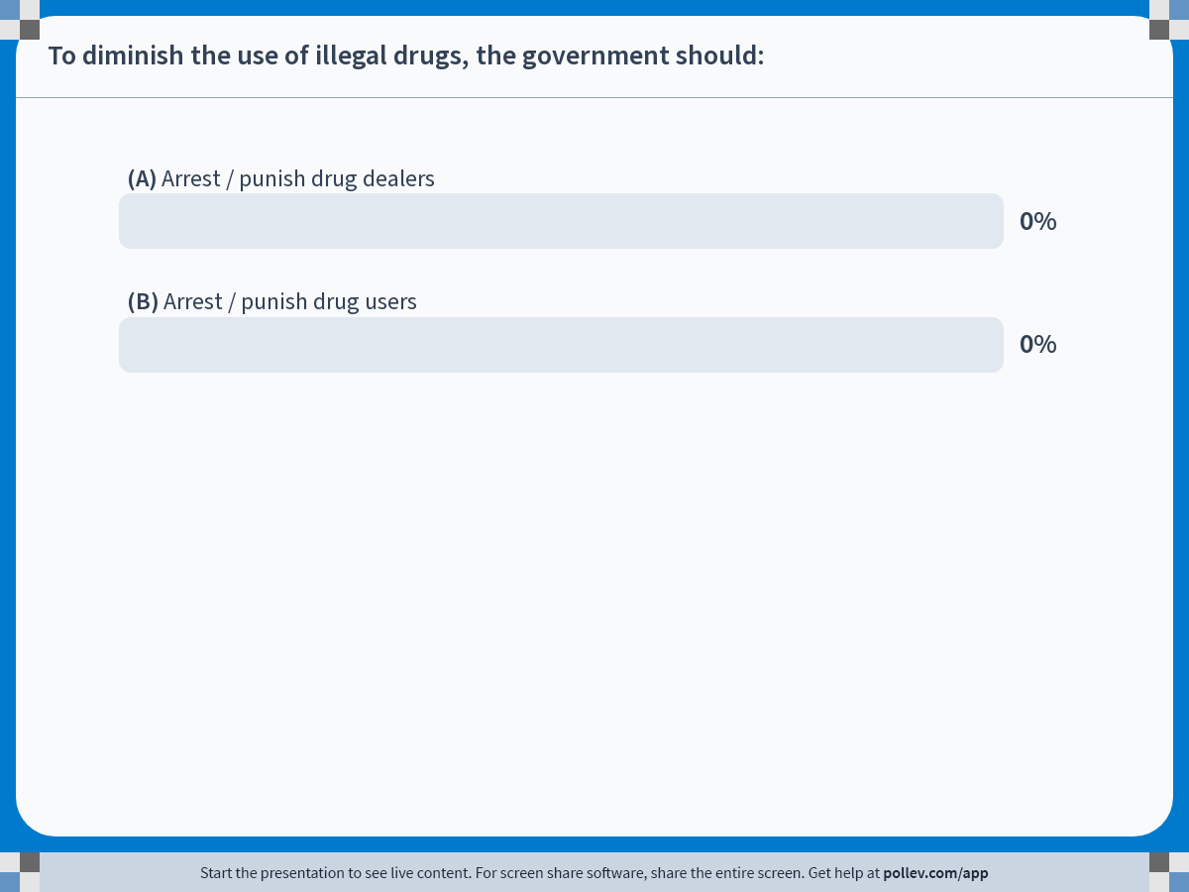
Notes:
Poll Title: Do not modify the notes in this section to avoid tampering with the Poll Everywhere activity. More info at polleverywhere.com/support To diminish the use of illegal drugs, the government should: https://www.polleverywhere.com/multiple_choice_polls/SvRjzmwXUb4CnEPPO8MVg?state=opened&flow=Default&onscreen=persist

Slide 5
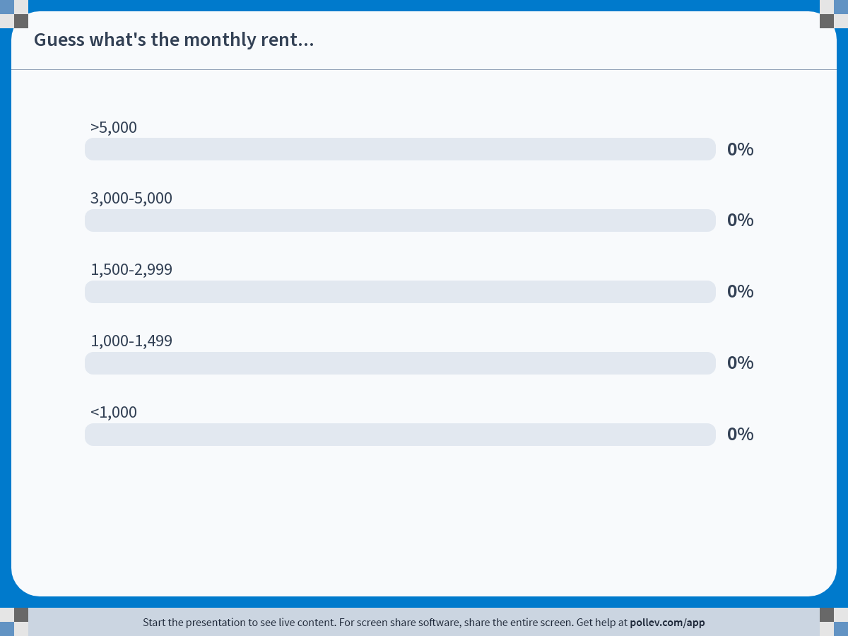
Notes:
Poll Title: Do not modify the notes in this section to avoid tampering with the Poll Everywhere activity. More info at polleverywhere.com/support Guess what's the monthly rent... https://www.polleverywhere.com/multiple_choice_polls/Ba4892DreAxLjvidjmrOV?state=opened&flow=Default&onscreen=persist

Slide 6
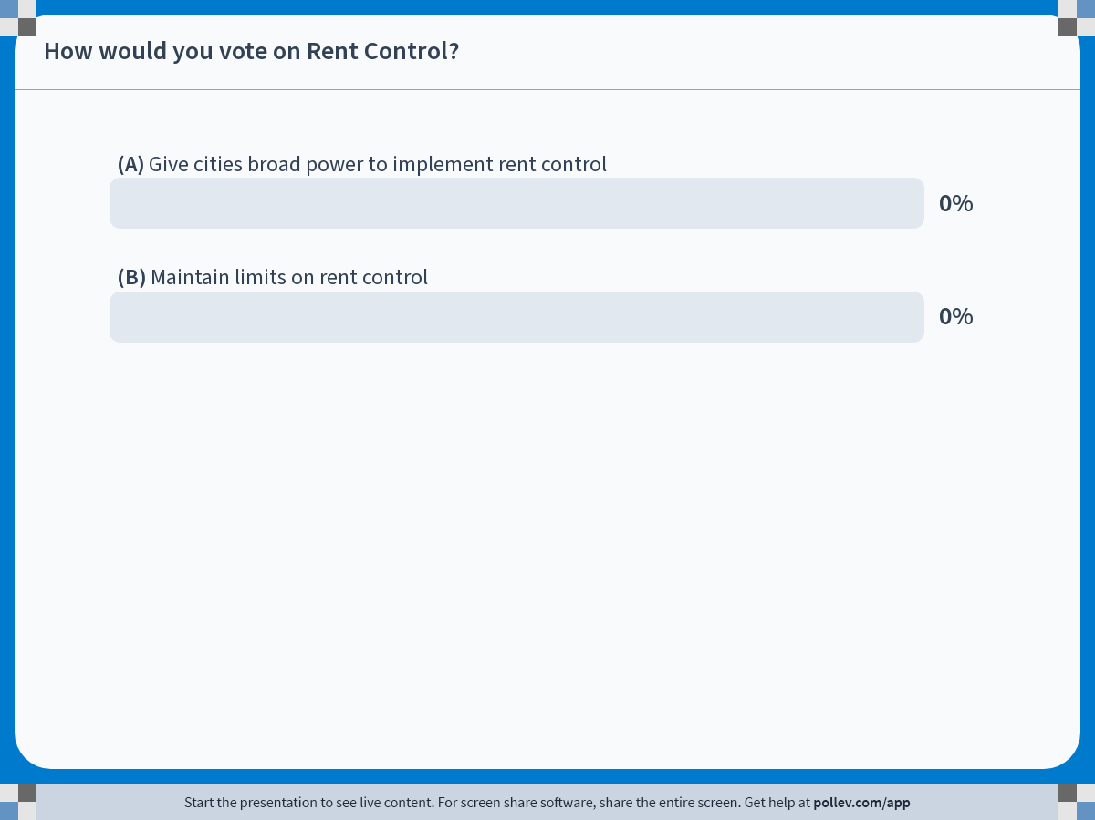
Notes:
Poll Title: Do not modify the notes in this section to avoid tampering with the Poll Everywhere activity. More info at polleverywhere.com/support How would you vote on Rent Control? https://www.polleverywhere.com/multiple_choice_polls/D2AlsqXROD7b3ZuuvOogV?state=opened&flow=Default&onscreen=persist

